Slide 1

ARTIFICIAL INTELLIGENCE
KALAIVANI B
Notes:
Algerian

Slide 2
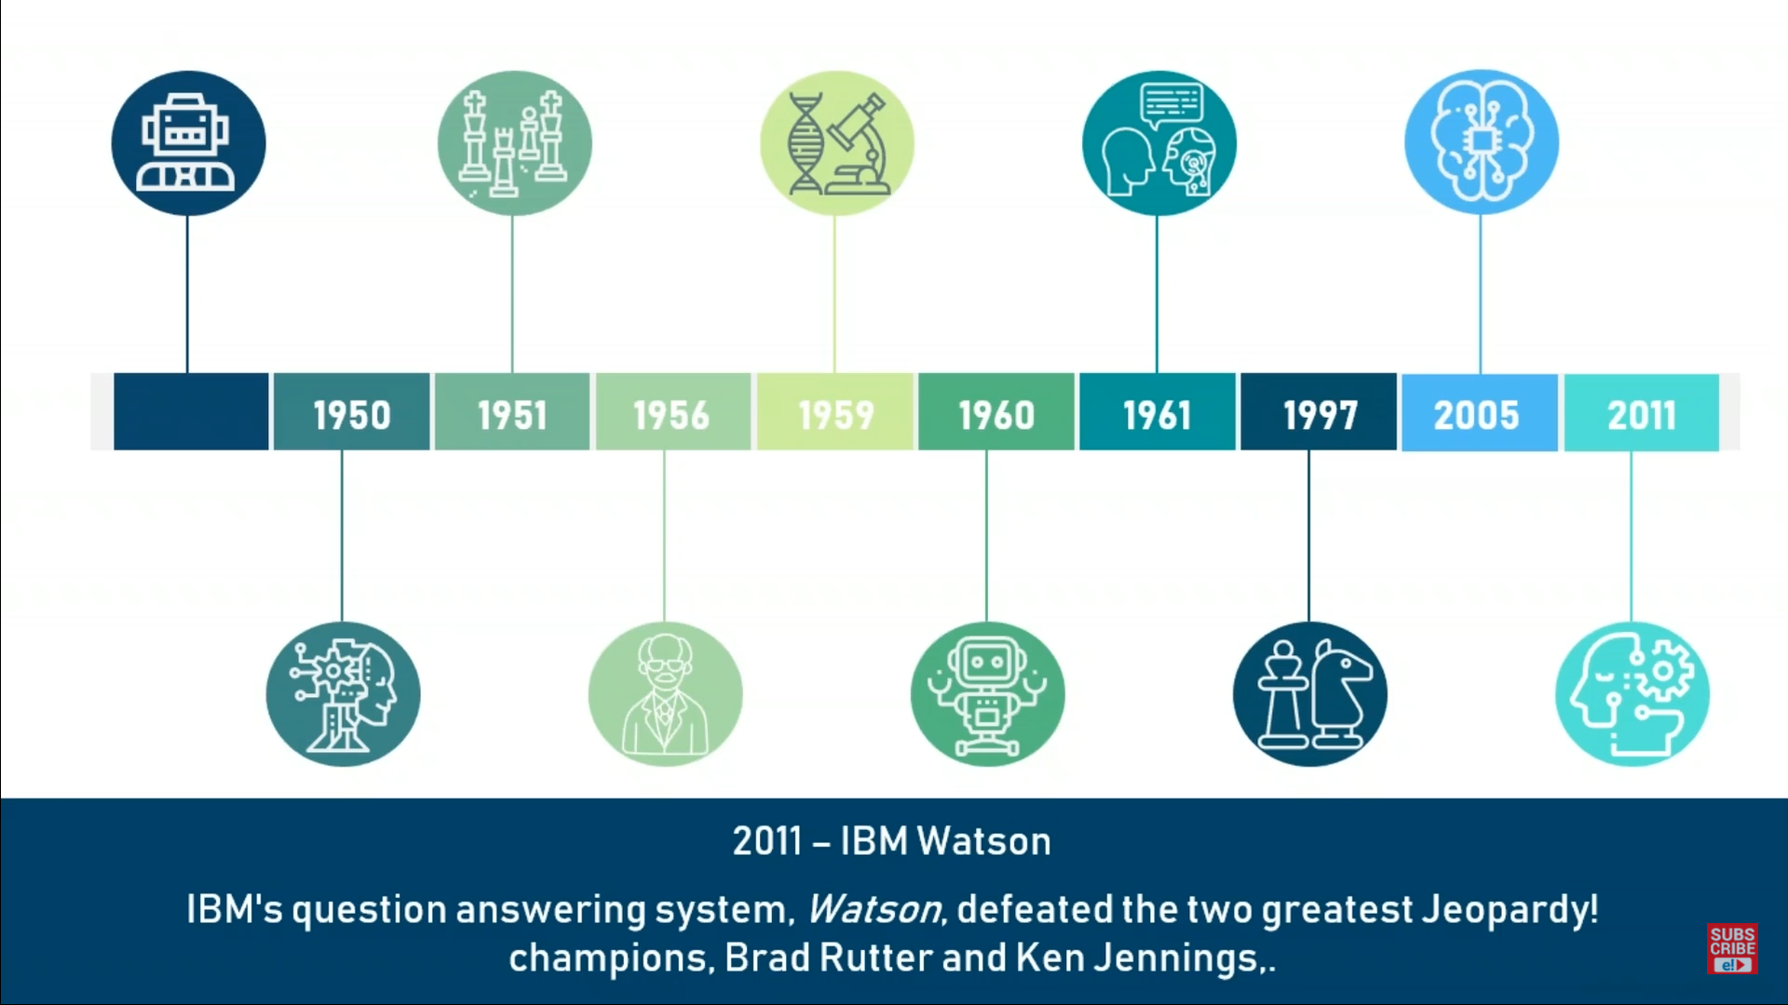
HISTORY OF AI
CHRISTOPHER STRACHEY - CHECKERS
DIETRICH PRINZ - CHESS
FIRST AI CHATBOT “ELIZA”
STANFORD RACING TEAM’S ROBOTIC CAR “STANLEY” WINS DARPA CHALLENGE
TALOS, AN ANIMATED WARRIOR IN GREEK MYTHOLOGY
MIT LAB WAS SET UP
ALAN TURING PROPOSED “TURING TEST”
JOHN McCARTHY USED AI AT DARTMOUTH CONFERENCE
FIRST MOTOR WAS INTRODUCED TO GENERAL MOTORS ASSEMY LINE
IBM DEEP BLUE BEATS WORLD CHAMPION GARRY KASPAROV IN CHESS
IBM WATSON DEFEATED BRAD RUTTER AND KEN JENNINGS

Slide 3

WHAT IS ARTIFICIAL INTELLIGENCE?
JOHN McCARTHY
THE SCIENCE AND ENGINEERING OF MAKING INTELLIGENT MACHINES
THE THEORY AND DEVELOPMENT OF COMPUTER SYSTEMS TO PERFORM TASKS NORMALLY REQUIRING HUMAN INTELLIGENCE, SUCH AS VISUAL PERCEPTION, SPEECH RECOGNITION, DECISION MAKING AND TRANSLATION BETWEEN LANGUAGES.

Slide 4
APPLICATIONS OF AI
GOOGLE DUPLEX
It can not only respond to calls and book appointments, but it does all with a human touch
J.P.Morgan Chase’s Contract Intelligence
COiN Uses AI, Machine Learning and Image recognition software to analyze legal documents
IBM WATSON
Healthcare organizations use IBM AI (Watson) technology for medical diagnosis. (Leukemia)
NETFLIX
Recommendations are made by Machine learning
FACEBOOK
Uses Machine learning and Deep learning to detect facial features and tag your friends
GOOGLE
Google’s AI Eye Doctor can examine retina scans and identify a condition called “Diabetic retinopathy” that can cause blindness

Slide 5

TYPES OF AI
present
near future
hypothetical
Artificial Narrow Intelligence
Artificial General Intelligence
Artificial Super Intelligence
Also known as “Weak AI”.
Involves applying AI only to specific tasks.
E.g: Alexa, Google search engine,
Strong AI
Involves machines that possess the ability to perform only intellectual task that a human being can.
Refers to the time when the capability of computers will surpass humans

Slide 6
Programming Languages for AI
PYTHON
R
JAVA
LISP (JOHN MCCARTHY)
PROLOG
C++

Slide 7
Free and open source
High - level language
Simple and easy to learn
Portable
Supports different programming paradigm
Easy code for AI and ML
USES OF PYTHON
Predefined packages
Extensible

Slide 8



NEED FOR MACHINE LEARNING
Increase in Data generation
Uncover patterns and trends in data
Improve decision making
Solve complex problems

Slide 9


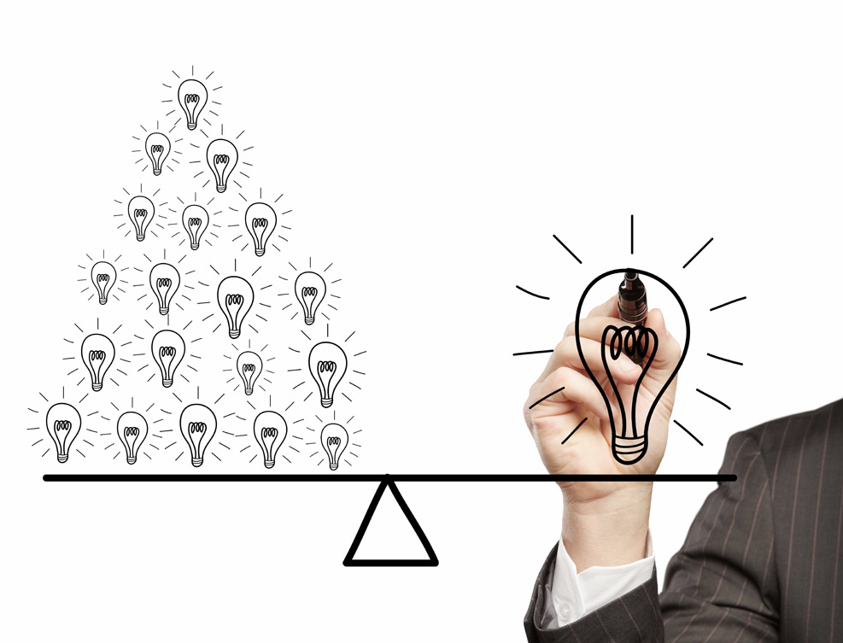

MACHINE LEARNING
Arthur Samuel first coined the term Machine Learning in the year 1959.
Machine learning is a subset of AI which provides machines the ability to learn automatically and improve from experience without being explicitly programmed.

Slide 10
DEFINITIONS
ALGORITHM : A set of rules and statistical techniques used to learn patterns from data.
MODEL: A model is trained by using a Machine Learning algorithm.
PREDICTOR VARIABLE: It is a features) of the data that can be used to predict the output.
RESPONSE VARIABLE: It is the feature or the output variable that needs to be predicted by using the predictor variable(s),
TRAINING DATA: The Machine Learning model is built using the training data.
TESTING DATA: The Machine Learning model is evaluated using the testing data.

Slide 11
1) Define objective
2) Data gathering
7) Predictions
MACHINE LEARNING PROCESS
6) Model evaluation
3) Preparing data
5) Building a model
4) Data exploration

Slide 12
TYPES OF MACHINE LEARNING
SUPERVISED LEARNING
UNSUPERVISED LEARNING
REINFORCEMENT LEARNING
Training of machine using information that is unlabeled and allowing the algorithm to act on that information without guidance.
Part of machine learning where an agent is put in an environment and it learns to behave in this environment by performing certain actions and observing the rewards which it gets from those actions
We teach or train the machine using data which is well labeled.

Slide 13
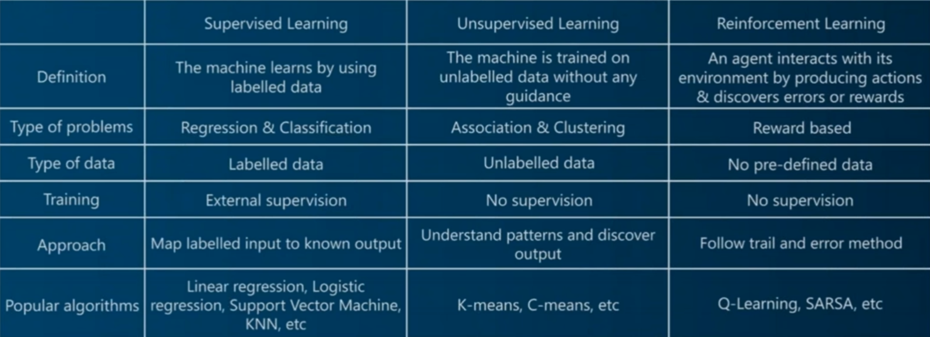

Add your title
Add your title
Add your title
Add your title
Add your title
Add your words here
Add your words here
Add your words here
Add your words here
Add your words here

Slide 14
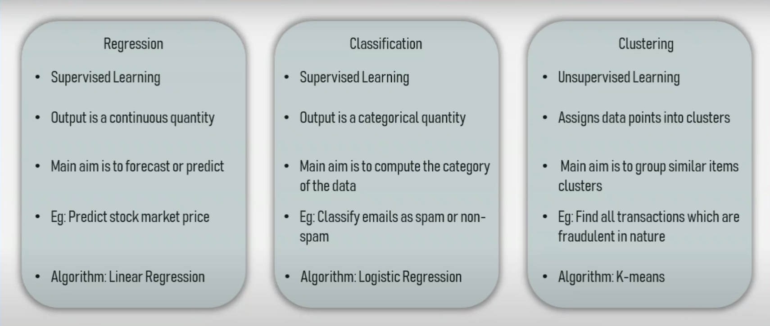

Slide 15
f
SUPERVISED LEARNING ALGORITHMS
Linear Regression - Method to predict dependent variable (Y) based on values of independent variables (X). Used for cases where we want to predict some continuous quantity. (REGRESSION ALGORITHM)
Logistic Regression - Method used to predict a dependent variable. Given a set of independent variables, such that the dependent variable is categorical. (CLASSIFICATION ALGORITHM)
Decision Tree - It is a supervised Machine Learning algorithm which looks like an inverted tree, wherein each node represents a “predictor variable” (feature), the link between the nodes represents a Decision and each leaf node represents an outcome (response variable). (CLASSIFICATION ALGORITHM)

Slide 16
DECISION TREE TERMS Entropy It measures the impurity or uncertainty present in data.
Information gain (IG) It indicates how much information a particular feature/variable gives us about the final outcome.

Slide 17
Random Forest - Builds multiple decision trees (called the forest) and glues them together to get a more accurate and stable prediction. (CLASSIFICATION ALGORITHM) It is used for (1) More accuracy, (2) To avoid overfitting and (3) Bagging.
Naive Bayes Classifier - Based on Bayes theorem that is used to solve classification problems by following a problematic approach. It is based on on the idea that the predictor variables in a Machine learning model are independent of each other. It is a parametric model because it has assumptions that all independent variables are no way related to each other.
K Nearest Neighbour - Supervised learning algorithm that classifies a new data point into the target class, depending on the features of its neighbouring data points. It is simple, non - parametric, lazy algorithm. (CLASSIFICATION AND REGRESSION ALGORITHM)

Slide 18
Support Vector Machines - Separates data using hyperplanes. (REGRESSION AND CLASSIFICATION ALGORITHM)
UNSUPERVISED LEARNING ALGORITHMS
K - MEANS CLUSTERING - The process by which objects are classified into a predefined number of groups so that they are as much dissimilar as possible from one group to another group, but as much similar as possible within each group.
REINFORCEMENT LEARNING TERMINOLOGIES
Agent - The RL algorithm that learns from trial and error.
Environment - The world through which the agent moves.

Slide 19
Action (A) - All the possible steps that the agent can take.
State (S) - Current condition returned by the environment.
Reward (R) - An instant return from the environment to appraise the last action
Policy (PI) - The approach that the agent uses to determine the next action based on the current state.
Value (V) - The expected long-term return with discount, as opposed to the short-term reward R.
Action value (Q) - Similar to value, except, it takes an extra parameter, the current action (A).

Slide 20
LIMITATIONS OF MACHINE LEARNING
REWARD MAXIMIZATION
MARKOV’S DECISION PROCESS
High dimensional data
Image recognition
Feature extraction
Reward maximization theory states that, a RL agent must be trained in such a way that, he takes the best action so that the reward is maximum.
The mathematical approach for mapping a solution in reinforcement learning is called MDP

Slide 21
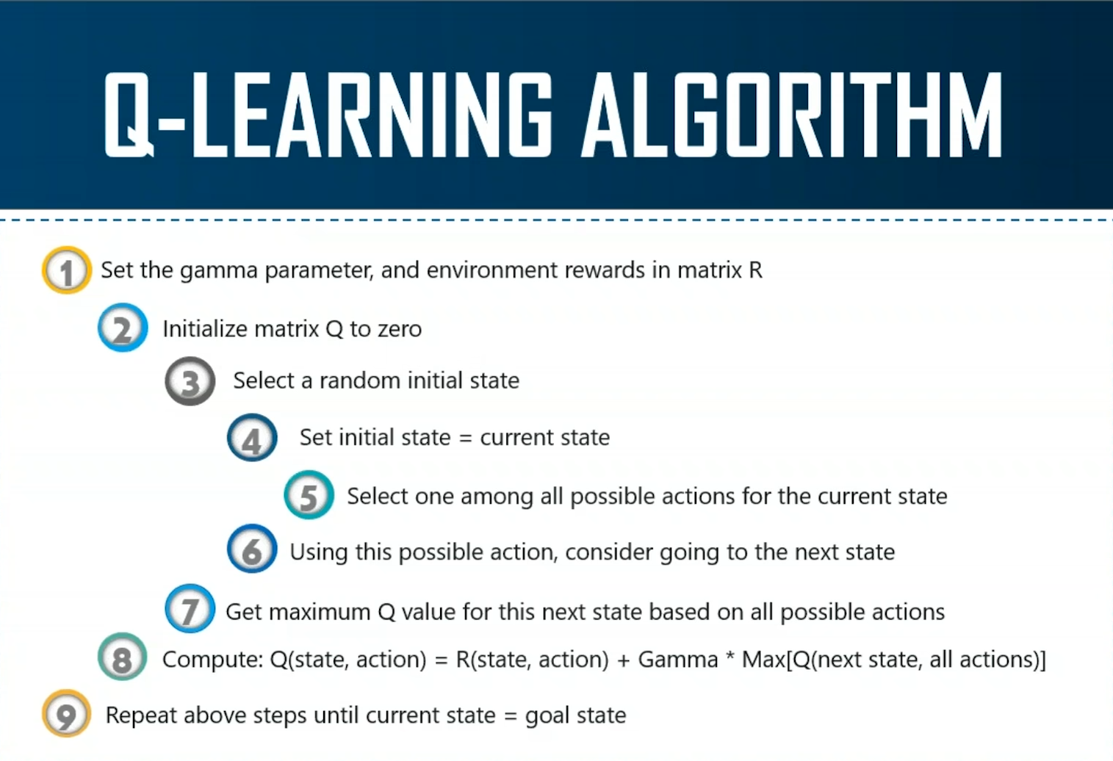

Slide 22
ARTIFICIAL INTELLIGENCE is a technique which enables machines to mimic human behavior.
MACHINE LEARNING is a subset of AI technique which use statistical methods to enable machines to improve with experience
DEEP LEARNING is a subset of ML which make the computation of multi-layer neural network feasible

Slide 23
DEEP LEARNING
Deep learning models are capable to focus on the right features by themselves, requiring little guidance from the programmer. These models also partially solve the dimensionality problem

Slide 24
PERCEPTRON
An artificial neuron or a Perceptron is a linear model used for binary classification.
It models a neuron which has a set of inputs, each of which is given a specific weight.
The neuron computes some function on these weighed inputs and gives the output.
MULTILAYER PERCEPTRON
A multi-layer perceptron has the same structure of a single layer perceptron but with one or more hidden layers and is thus considered a deep neural network. BACKPROPAGATION IS A SUPERVISED LEARNING METHOD FOR MULTILAYER PERCEPTRON

Slide 25
RECURRENT NEURAL NETWORK
TEXT MINING
Text mining/ Text analytics is the process of deriving meaningful information from natural language text.
Text is turned into data for analysis, via application of Natural Language Processing (NLP)
NATURAL LANGUAGE PROCESSING
It is a part of a computer science and artificial intelligence which deals with human languages.
Recurrent networks are a type of artificial neural network designed to recognize patterns in sequences of data, such as text, genomes, handwriting, the spoken word, or numerical times series data emanating from sensors, stock markets and government agencies.
CONVOLUTIONAL NEURAL NETWORK
The neuron in a layer will only be connected to a small region of the layer before it, instead of all of the neurons in a full-connected manner.

Slide 26
APPLICATION OF TEXT MINING AND NLP
CHATBOT
MACHINE TRANSLATION
SPEECH RECOGNITION
INFORMATION EXTRACTION
SPAM DETECTION
SENTIMENTAL ANALYSIS
KEYWORD SEARCH
ADVERTISEMENT MATCHING
AUTOCOMPLETE
SPELL CHECKER
PREDICTIVE TYPING

Slide 27

1
2
3
TOKENIZATION
The process of splitting the whole data (corpus) into smaller chunks.
Break a sentence into words.
Understand the importance of each of the words with respect to the sentence
Produce a structural description on an input sentence
STEMMING
Normalize words into its base form or root form.
LEMMATIZATION
Group together different inflected forms of a word, called Lemma.
Output is always a proper word.
Similar to stemming, it maps several words into one common root.

Slide 28
THANK YOU

